Slide 1
Research Computing Update
June 2020

Slide 2
HPC Resources
KU HPC Cluster
Continuing with re-registration process for all HPC users. This was to remove inactive accounts, as well as to collect project and PI information from users.
PR for support for h/w is still in process.
SAN HPC
Still outstanding is the renewal of the contract for onsite engineer contract.
New HPC Procurement via ANKABUT
Still in process.

Slide 3
Training
“Research Computing intro session”, “Introduction to Linux”, and “Introduction to HPC” courses are all well attended and well received.
Training calendar is available at https://teamup.com/ksquu2jki56nesnr6n
Due to course being online, places are limited to 5 per session.
All three courses are delivered on a weekly basis.
Continuing to schedule three courses per week, and sending out invites at beginning of the month.

Slide 4
Resource Utilization

Slide 5
KU Cluster core distribution

Slide 6
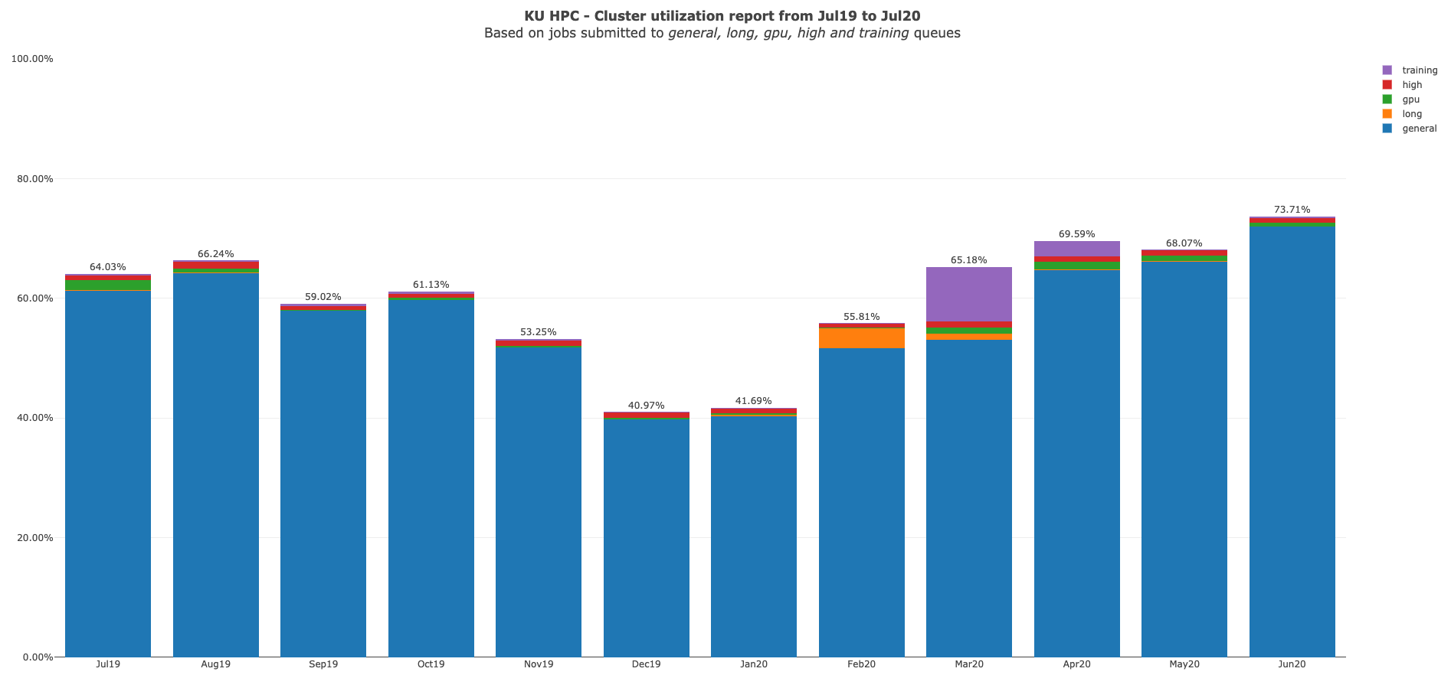

Slide 7
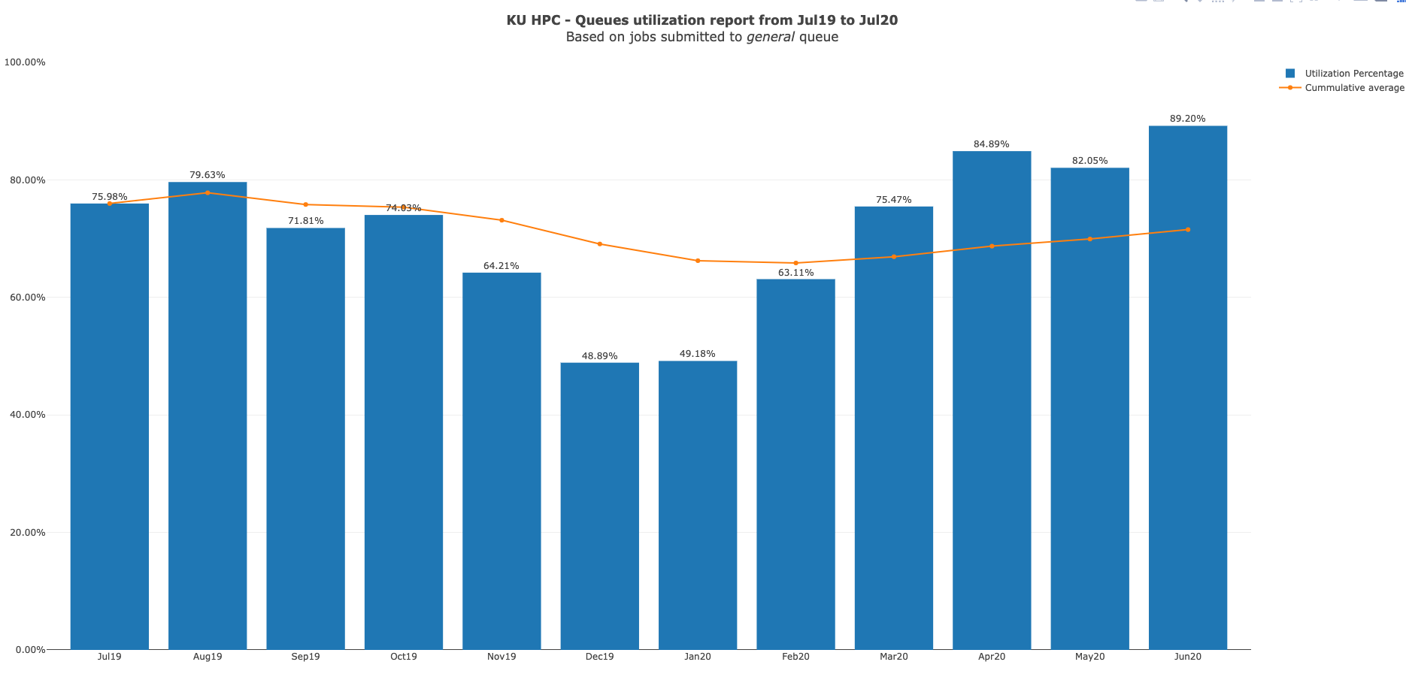

Slide 8
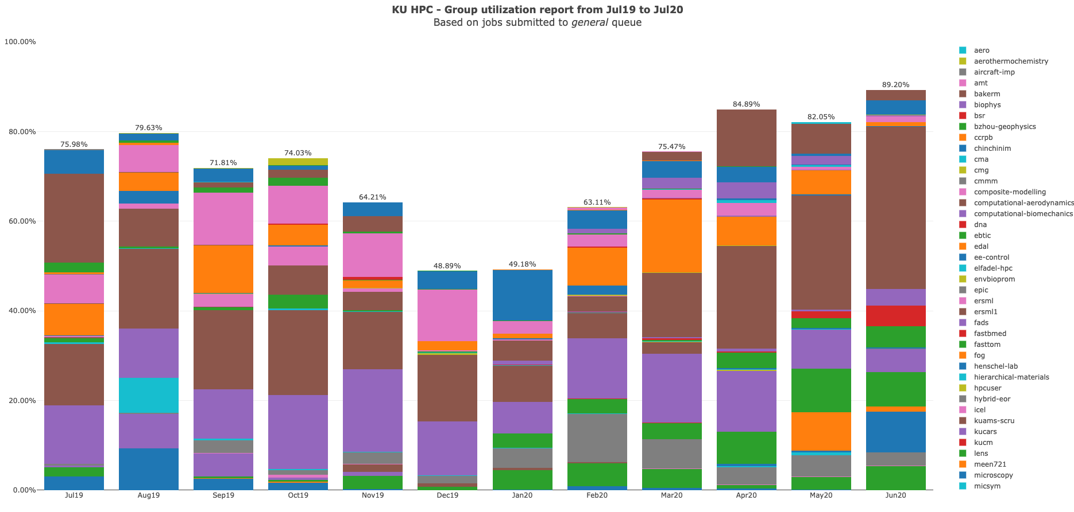

Slide 9
KU HPC Group Utilization for June 2020

Slide 10
PI Cluster core distribution

Slide 11
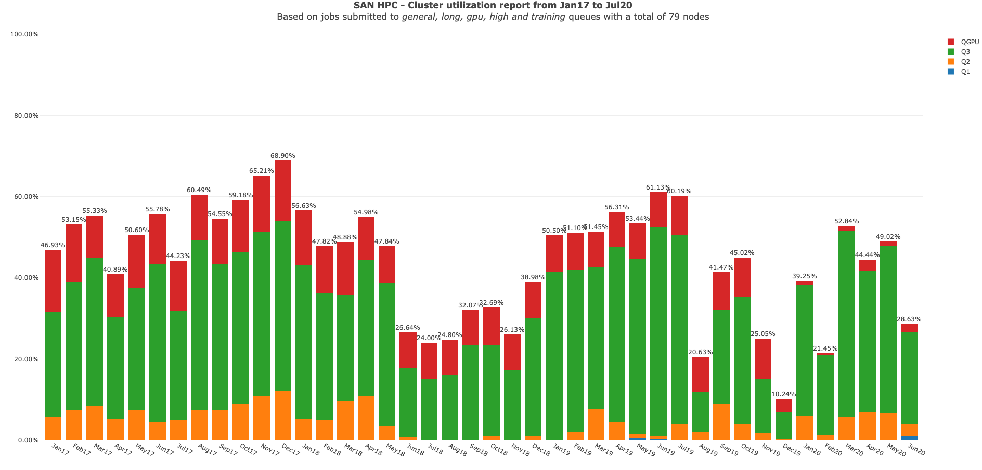

Slide 12
Status of KPI’s

